Slide 1
Post-Earning Price Movement
April 21, 2022
Team4 Members:
Yashuo (Gloria) Wang (yw489)
Ziang Qi (zq41)
Dhruv Maheshwari (dm466)
Aazim Jaheez (aaj29)
Shubo Huang (sh610)

Slide 2
Executive Summary
The primary goal of our project is to forecast the magnitude of the change in share price post-earnings by analyzing actual vs estimated earnings together with both stock-specific and macroeconomic factors, thus allowing us to derive Trading Signals.
By modeling the abovementioned data, we developed a predictive mechanism which performs relatively well on companies in Traditional Industries as well as those that Missed their earning estimates.

Slide 3
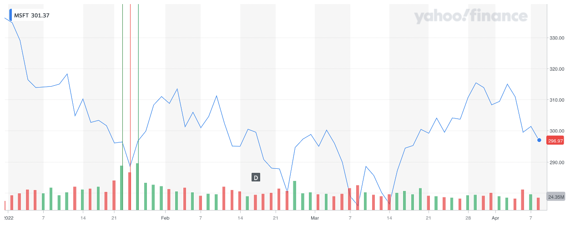
Business Background
Microsoft’s Stock Price change after Earnings Announced
313.46
288.49
296.37
296.71
Notes:
This is a plot for Microsoft's stock price. On January 25th 2022, after the company announced a diluted EPS with a 22.4% increase, the stock price increased 2.8% in one day and stopped decreasing for the next few days. There is some relationship between the earning announcement and the magnitude of change in share price for the firm. So our goal is the forecast the percentage change in share price that allow us to provide the trading signal with respect to the observed and predicted earnings generated by some analysts.

Slide 4
Objective Formulation
PEAD
Lack of Literature
Usefulness
Post-Earning Accouncement Drift
Corr vs Prediction
Leverage Trading Signal
“…data indicates that the market does use the information provided by estimates and quarterly earnings reports, and at least in the short run, the earnings surprise is significantly correlated with regards to volatility and overnight returns²”
While there are literature studying the correlation between earnings and overnight returns³, we have not found any statistical/Machine Learning models which help to predict such return.
We believe building this predictive model can provide signals for such models and model users. In addition, we hope to find actionable insights while exploring the data and interpreting the modeling results.
“The Post-Earnings-Announcement Drift¹ refers to an anomaly in financial markets. It describes the drift of a firm’s stock price in the direction of the firm’s earnings surprise for an extended period of time.”
However, by observing the market, we know that the immediate price movement does not always align with the direction of the earnings surprise.
*See Appendix for a PEAD Timeframe
Notes:
1.Josef Fink, A review of the Post-Earnings-Announcement Drift, Journal of Behavioral and Experimental Finance, Volume 29, 2021, 100446, ISSN 2214-6350, https://doi.org/10.1016/j.jbef.2020.100446
2.Sam Lim, Assessing the Effects of Earnings Surprise on Returns and Volatility with High Frequency Data , 2009, http://public.econ.duke.edu/~get/browse/courses/201/spr12/2010-PRESENTATIONS/FullECON202-FINAL_PAPERS/2009-December/Lim_Thesis.pdf
3.An, Qian, & Zheng, Stock Market Trends Prediction after Earning Release, 2016, http://cs229.stanford.edu/proj2016/report/Qian_Zheng_An-StockMarketTrendsPredictionAfterEarningRelease-report.pdf
4. (Figure. Time Line) Liang, POST-EARNINGS ANNOUNCEMENT DRIFT AND MARKET PARTICIPANTS’INFORMATION PROCESSING BIASES, 2002
The Post-Earning-Annoucement-Drift is too long for actual traders to develop trading strategies on. We narrowed it down to 1-Day after earnings are released because it gives ample time for the market to react to the signal and also allows the users of our model to investigate the result, gather more information, and incorporate the signals developed by our model into their trading actions.

Slide 5
1
Modeling Results
AGENDA
2
Modeling Process
3
Data Collection
4
Exploratory Data Analysis
5
Limitation & Next Steps

Slide 6
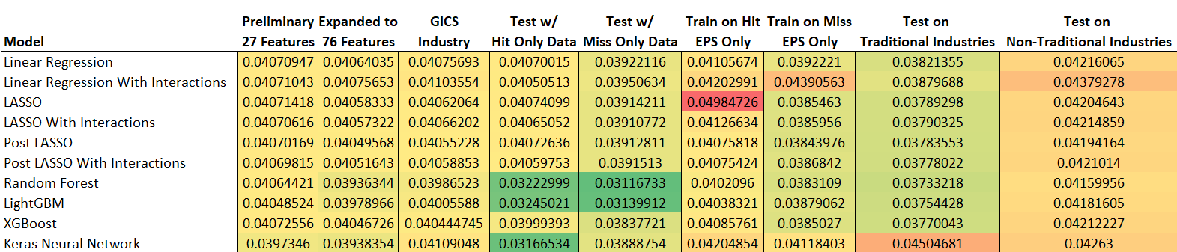
Modeling Results
Average RMSE Comparision
The modelling results improved as we populated the dataset with extra variables via feature engineering
Overall, the Random Forest and LightGBM models outperformed the rest
The models performed especially well on “Miss Only” and “Traditional Industry” subsets
* Traditional Industries include Consumer Discretionary, Consumer Staples, Energy, Industrials, Materials, Real Estate, Utilities and Financials
** Non-Traditional Industries include Communication services, Health Care, Information Technology
Notes:
We started the modelling process with the preliminary dataset that we obtained from the sources, where the Random Forest, LightGBM and Neural Network models performed the best.
The modelling results improved as we retrained our models with additional features that we generated via feature engineering. [Add why] In this case, the Random Forest, LightGBM, XGBoost and Neural Network models are the best performers.
After adding the GICS industry identifications, the models performed about the same. [Add why]
We tested the Hit & Miss Only data using the same models. The RMSE results showed that our models performed better on the Miss Only subset. [Add why]
Robustness tests:
Retrained the models on Hit/Miss Only data. Again, the models performed better on Miss Only dataset than Hit Only dataset.
Retrained the models on Traditional/Non-traditional industries. The models performed better on traditional industries than non-traditional industries. [Add why]

Slide 7
1
Modeling Results
AGENDA
2
Modeling Process
3
Data Collection
4
Exploratory Data Analysis
5
Limitation & Next Steps

Slide 8
Modeling Process
List of Models
1. Linear Regression
2. Linear Regression With Interactions
3. LASSO
4. LASSO With Interactions
5. Post LASSO
6. Post LASSO With Interactions
7. Random Forest
8. XGBoost
9. LightGBM
10. Keras Neural Network
These models are the most commonly used models to predict a numeric variable
We picked models with a range of complexity from a simple Regression to advanced Machine Learning
We also considered the nature of the models to include both regression models and tree-based models
Notes:
Started out the modelling process with the basic models such as linear regression and linear regression with interactions
Applied lasso and post lasso regualisations on both linear regression and linear regression with interactions

Slide 9
Modeling Process
Preliminary
Data
Feature Engineering
Industry Sectors
Test on
H/M Only
Re-Train with H/M
Test on Industry
27 Features
Expanded to
76 Features
Added 11 Sectors
(Total of 87 Features)
Non-Specific Model
Testing on Hit/Miss
Only Data
Non-Specific Model
2 New Models
Hit Specific Model +
Miss Specific Model
2 New Models
Traditional Industry
Specific Model +
Non-Trad Industry
Specifc Model
Notes:
The preliminary dataset includes 27 features - ranges of estimates, earnings, returns, risk free rates, VIXs.
Expanded to 76 features after adding the variables via feature engineering
Added 11 GICS sectors as our final dataset and ran all models
Used the same models to test on Hit/Miss Only Data
Retrained models on Hit/Miss Only dataset
Retrained models on Tradtional/Non-traditional industries dataset

Slide 10
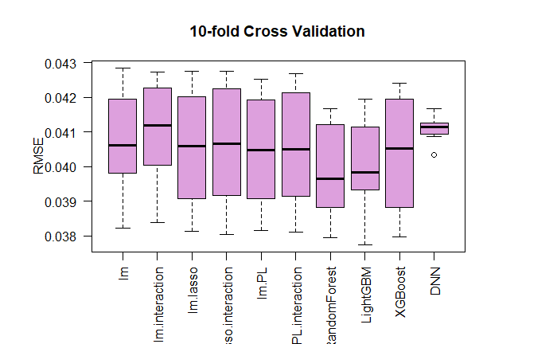
Modeling Results
Notes:
The modelling results for the dataset that includes GICS sectors.
The Random Forest and LightGBM models are the best performing ones among all.
The performances of our Neural Network model are unstable every time we ran the models. One of the reasons might due to numerical precision getting lost as more layers added. And the fact that small changes in initial layers can propagate through a dense network, might also be one of the reasons for final different outputs. Another reason might also be because neural network is a stack of non-linearities which is a complex system that could result in different solutions in different runs. Traditional machine learning might not have the same complexity.

Slide 11
1
Modeling Results
AGENDA
2
Modeling Process
3
Data Collection
4
Exploratory Data Analysis
5
Limitation & Next Steps

Slide 12
Potential Drivers of the PEAD¹
Risk and uncertainty
[VIX + Price Volatility]
01
04
Earnings autocorrelation and mis-specified expectation models
[Analysts Estimates +
Historical EPS]
PEAD
Trading frictions and arbitrage
02
Inattention and behavioral biases
[EMA & Lag Variables]
03
Cross-sectional drivers of earnings processes and expectation models
[GICS Sector
+ Market Risk Free Data]
05
Notes:
To narrow down on a list of features which can be useful in predicting the price movement after Earning Call, we studied numerous literatures, and we found a research paper which mentioned the potential drivers of the PEAD. Although our primary target is not PEAD, after consulting with professionals, we believe the same set of drivers also applies to price movement immediately after earnings call. These five factors are shown on the graph. As some of those drivers are hard to quantify, we tried our best to find data which can approximate those drivers. First of all, we used the VIX Index and the stock price volatility to measure the risk and uncertainty. Then we used the Exponential Moving Averages and Lag variables to capture the inattention and behavioral biases. The earnings autocorrelation and mis-specified expectation models are approximated by the analysts’ estimation data and historical EPS and post-EPS price movement data. Last but not least, we approximated the cross-sectional drivers of earning processes and expectation models with GICS Sector data and Market Risk Free Rate. We were not able to find suitable features and data to approximate the trading frictions and arbitrage but after conducting analysis, we feel the factors already captured most of the thing which can be quantified.
Source Cited: Josef Fink, A review of the Post-Earnings-Announcement Drift, Journal of Behavioral and Experimental Finance, Volume 29, 2021, 100446, ISSN 2214-6350, https://doi.org/10.1016/j.jbef.2020.100446.

Slide 13
Feature Engineering
Past Price Movement (Yahoo Finance)
Daily Open, High, Low, Close, and Adj. Close prices of SP500 companies
Earning Estimates (WRDS)
High/Low/Median/Mean of estimates
Number of estimates
Timing of estimates
27 Original Features
Macro-Economic Factors (Yahoo, CBOE, Wiki)
Calculated Features
58 additional features introduced
Total 76 features used
Industry (11 GICS Sectors)
Market Risk Free Rate (10-Year Treasury Price)
Market Volatility (VIX Index)
Notes:
We collect data from credible sources and started cleaning the data by filtering out missing values and combining separate datasets. Our primary data comes from three sources listed on the left. We defined the scope of our project to be 10 years and collected data from 3/1/2012 to 3/31/2021. We got detailed information for price from Yahoo Finance API, detailed earning estimate with actual EPS data from WRDS IBES, GICS industry factor from Wikipedia, risk-free rate from Yahoo finance, and SP500 VIX index from CBOE.
After gathering and merging with those data, we obtained 27 features (columns). As Shubo mentioned, we performed model testing on the initial 27 features and decided that the current set of features are not good enough to give up satisfactory result. Therefore, we performed feature engineering and introduced some new features. We dropped some features from the 27 group and generated 58 additional features.

Slide 14
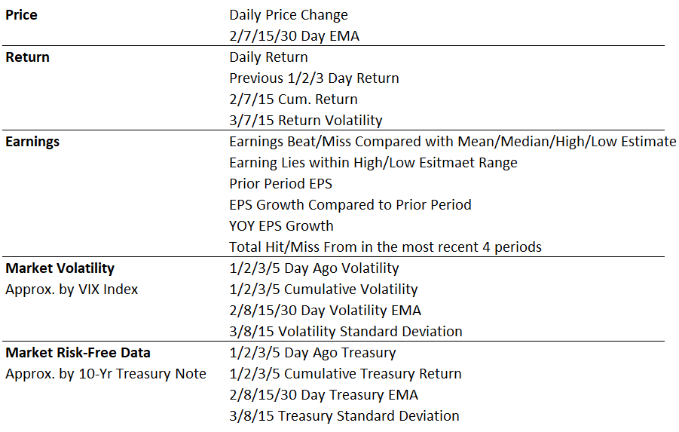
Calculated Features by Group
Notes:
The table above shows all the features we have generated from the original data from the database. For price data, we do not calculate the daily price change but also the EMA of the price, which is the exponential moving average that assigns a greater weight to the most recent data point. All the return data is calculated based on close prices, which most investors can use. New earning features are generated based on actual earnings and several estimates to create a range of estimates. The market volatility is based on SP500 VIX information and is calculated based on the VIX close. The risk-free market rate is from the ten-year treasury note and calculated base on fix income rate close.
Now we have a list of features, we want to further examine the correlation among the features, as well as some hidden patterns in the feature, so let me invite my friend Aazim to go through the Exploratory Data Analysis with you.

Slide 15
1
Modeling Results
AGENDA
2
Modeling Process
3
Data Collection
4
Exploratory Data Analysis
5
Limitation & Next Steps

Slide 16
Exploratory Data Analysis - Overview
1
Data Trend and Spread
Company earning trend over time
Characteristics and spread of certain features
2
EDA
Correlation Studies - Appendix
Inter-group feature correlation & Intra-group feature correlation
Detailed explanation and results are included in the Appendix
3
PCA & Clustering - Appendix
PCA failed due to lack of correlation among features
Clusters of Treasury and VIX can be included as additional features
Both results are included in the Appendix
Notes:
Our EDA was divided into three broad categories:
Analyze trends amongst the variables as well as their variance.
Grouping the variables and conducting correlation studies both within the group as well as amongst different groups.
Conducting a Principle Component Analysis and clustering analysis, both of which didnt provide significant results as there is fairly low correlation amongst the features.

Slide 17

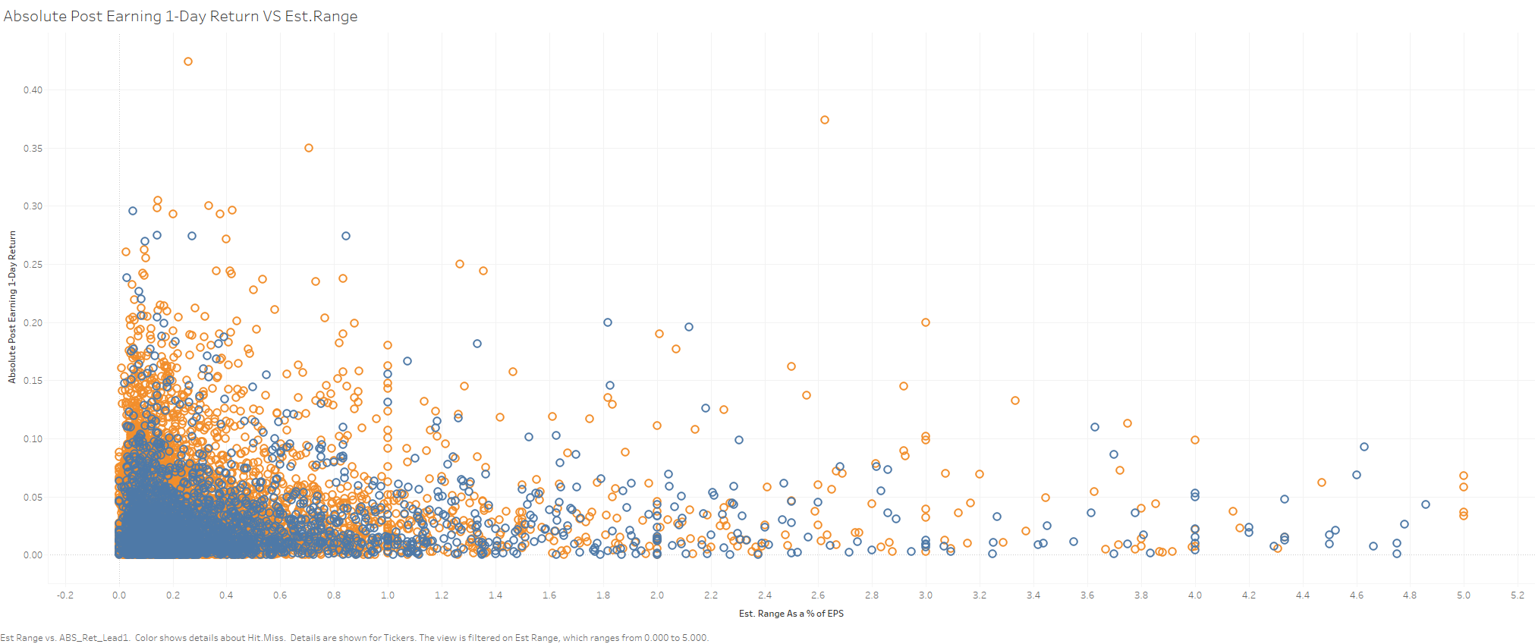
EDA - Feature Trend 1
Absolute Post Earning 1-Day Return VS Estimation Range
In general, the residuals of Random Forest, LightGBM and XGBoost models are significantly different than the rest of the models at the 0.05 significance level.
This result implies that these three models with lower RMSE perform the best
Notes:
The above graph indicates that the range of the analyst estimates shares an inversely proportional relationship with the 1-Day return after an Earnings call.
This makes intuitive sense since if the range is smaller, the likelihood of the actual earnings being within the range reduces leading to increased volatility for shorter ranges.

Slide 18
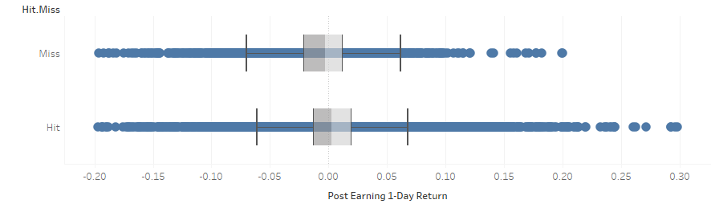
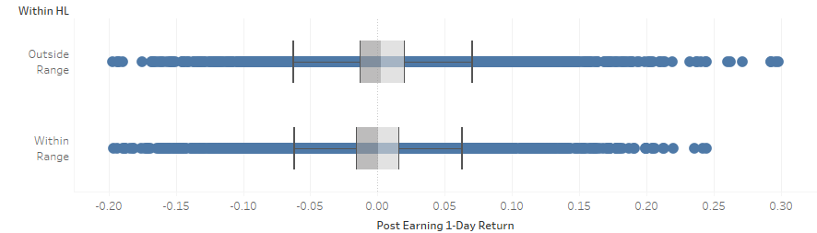
EDA - Feature Trend 2
Spread of 1-Day Post-Earning Return
Notes:
The first graph indicates that when analyzing subsets of Hit only and Miss only data, we find that the median 1-Day return tends to be higher when companies hit their earnings estimates as compared to when they Miss. Qualitatively, the share prices tend to perform well when companies hit their earnings estimates.
The second graph tells us that while the median 1-Day return tends to be similar regardless of whether the earnings fall within or outside of the estimate range, the upper bound of returns for estimates that fall outside the range tend to be higher. This is a clear indication of an Earnings Surprise, implying that earnings that fall above the estimate range results in higher returns.

Slide 19
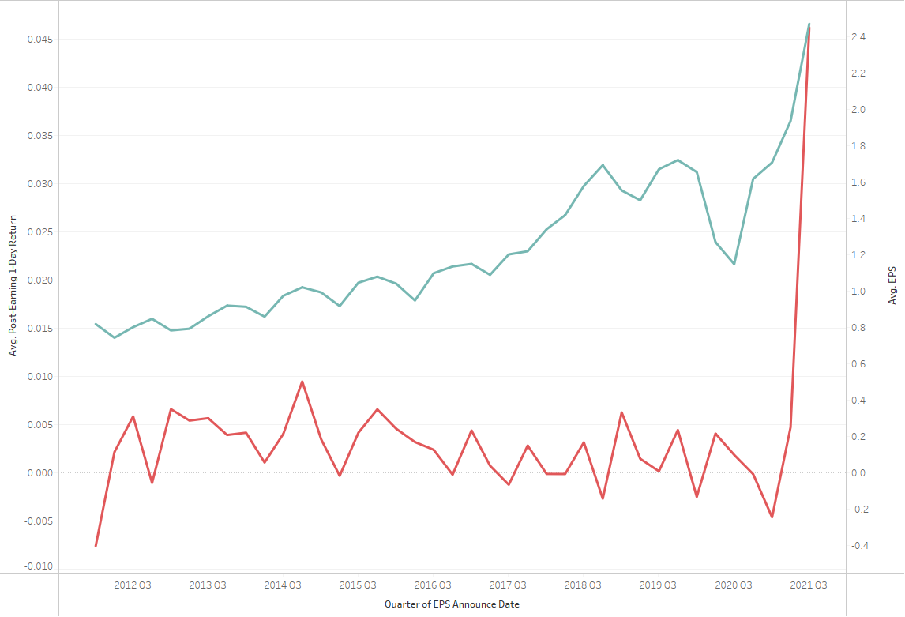

EDA - Feature Trend 3
Actual EPS VS 1-Day Post-Earning Return
Notes:
From the above graph, we observe a clear correlation between the 1-Day post earnings return and the actual EPS of a firm.

Slide 20
1
Modeling Results
AGENDA
2
Modeling Process
3
Data Collection
4
Exploratory Data Analysis
5
Limitation & Next Steps

Slide 21
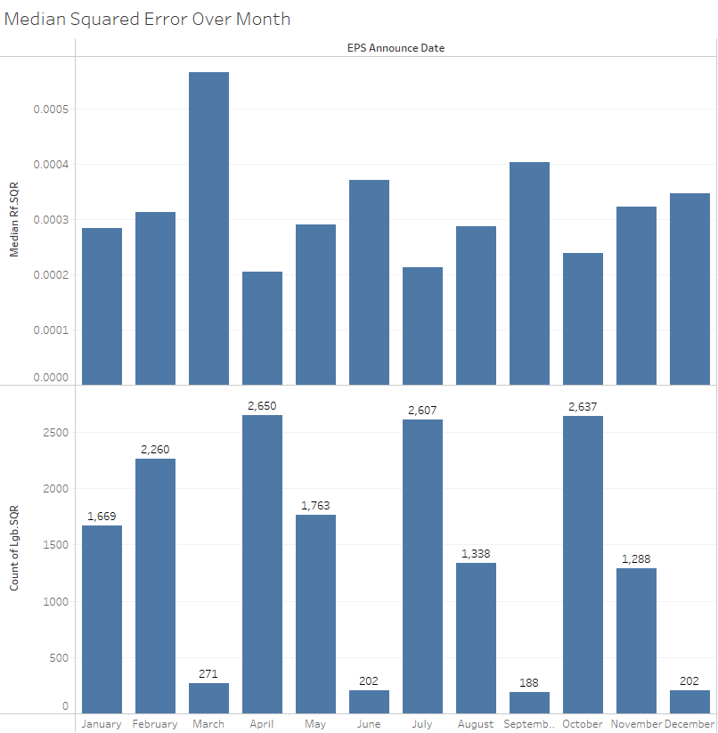
Model Performance Limitation
Number of companies announcing earnigs is invesely proporttional to the magnitude to the median squared error
Additional data points lower median the squared error
Large cross section will impove model accuracy
Notes:
Top Graph: Median squared error by EPS Announcement Month. Bottom graph: Number of companies announcing their respective earnings by EPS Announcement Month. Trend: number of companies announcing their earnings is inversely proportional to the median error for the given month. For example: consider March and April. In march 271 companies declared their earnings while in April almost 10x ~ 2650 companies released their earnings. This directly transcends inversely to the respective median squared errors. Therefore, more data points allow for a lower median squared of error. The scope for this project was for 10 years. Hence, a large cross section of data points will improve model accuracy.

Slide 22
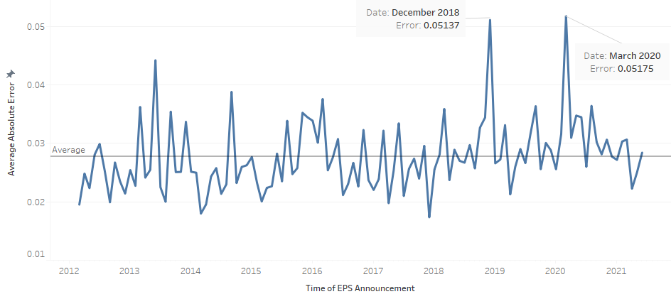
Model Performance Limitation
Notes:
This graph projects average absolute error v/s time in years of EPS announcement. If there is an abnormal events like in 2018 December and 2020 March. The model showcases significant error spikes, hampering the robustness of the model.

Slide 23
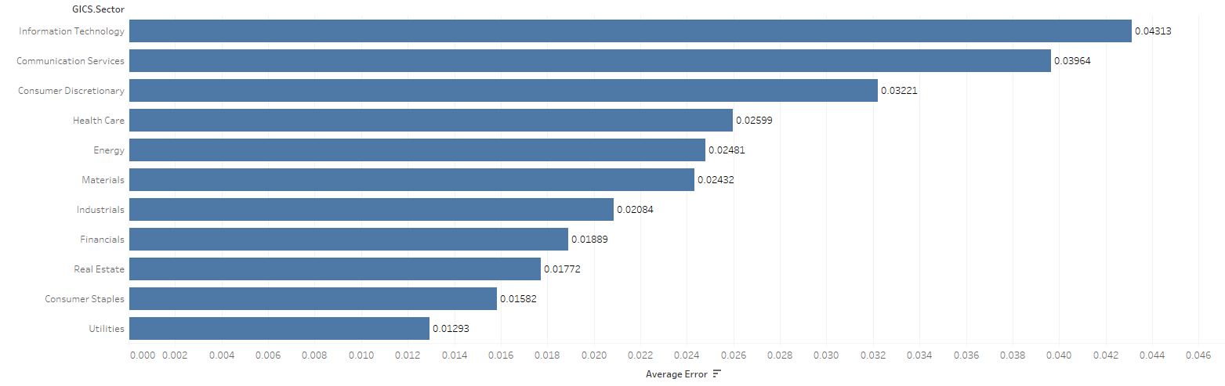
Model Performance Limitation
Models performed better for traditional sector rather than non-traditional sector
Sector specific KPI(s) can improve sector performance
Notes:
The Consumer Discretionary Sector encompasses those industries that tend to be the most sensitive to economic cycles. Its manufacturing segment includes automotive, household durable goods, textiles & apparel and leisure equipment.
The graph showcases individual sector v/s their respective average errors. This is in-line to model performance as depicted in the results section stating, model performs better for traditional section rather than non-traditional sectors. To improve this, we can bring sector specific KPI(s) to improve sector performance. For example: CPI (cunsumer priceindex) for improved performance of consumer discretionary.

Slide 24
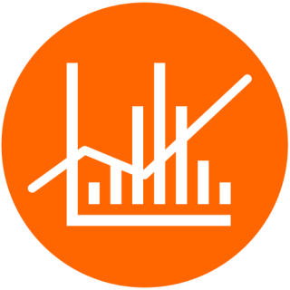
Limitation
Data
At a given point only a certain timeframe of data can be analyzed
Market Reaction
Scope: Market participants react not only to earnings information
Additional Information
Inherently complicated non-earning information. For example: change in leadership or black swan event
Features not captured
Income Statement projections, industry specific key performance indicator (KPI’s), firm specific news
Notes:
Analysis of limitations consists of four factors: Data, market reaction, additional information, and additional features not being captured. Data gathering and vastness throughly limits the scope of the timeline being considered and leads to exclusion of key events that might drastically impact model accuracy. For example: with the bounds of scope, the timelines for 2012-2021 are only being considered, not fully including 2008 crash. Market reaction is usually a culmination of multiple factors including EPS such as macroeconomic factors which are not being considered within the scope of the project. Along these lines; certain factors are difficult to model for example change in leadership which have an ability to directly affect price projections. Additionally, due to the limited timeline of the project features such as income statement projects i.e. revenue projections, COGS projections, depreciation and amortization in addition to firm specific idiosyncratic news is not being captured.

Slide 25
Next Steps
Data Expansion
Implementation
Area of current scope: S&P 500 constituents
Area of future scope to enhancence true predictability and robustness:
Wider range of companies - Russell 3000
Financial Statement Projections
Implementation with current predictive models as a add-on robustness test:
Improved EPS insights
Impoved sector focus
Notes:
The next steps key focus is improvement on prediction and robustness of model. Current scope of companies included S&P 500 constituents only. This can be further expanded to a much more holistics set. Therefore, including a greater cross section of US stock market for example; Russell 3000 index constituents. In addition, financial statement projections will aid positively to the robustness of the dataset. Moving forward, the model can be implemented as a add-on predictive model. Since, the scope of the project was EPS centric, the model can provide an additional layer of redundancy to the trading signal. Additonally, since the model has been more successful with traditional sectors, this will allow for imporved sector focus.

Slide 26

Post Earning
Price Movement Prediction
Thank You!
Presented by: Team 4
Date: April/21 2022

Slide 27
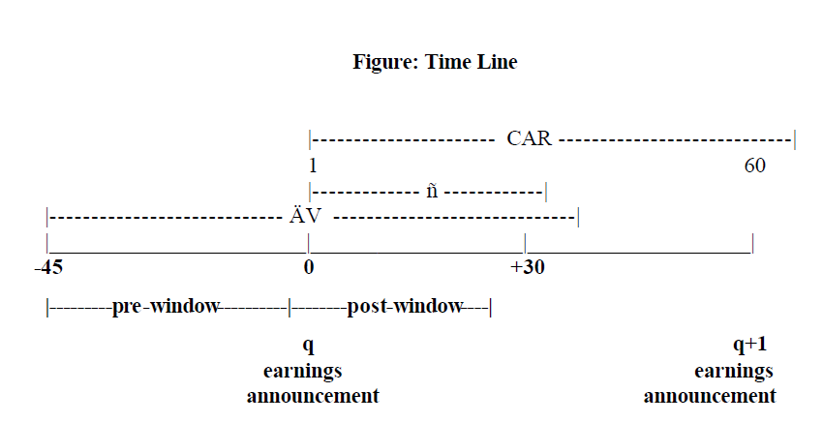
Appendix - PEAD Timeframe
A Graphic Representation of PEAD

Slide 28
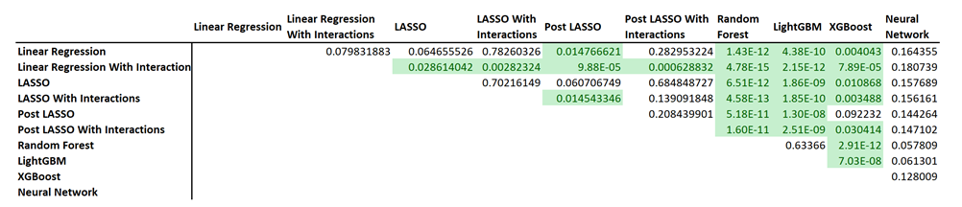
Appendix - Diebold-Mariano Test
DM-Test on Residuals Comparision
In general, the residuals of Random Forest, LightGBM and XGBoost models are significantly different than the rest of the models at the 0.05 significance level.
This result implies that these three models with lower RMSE perform the best

Slide 29
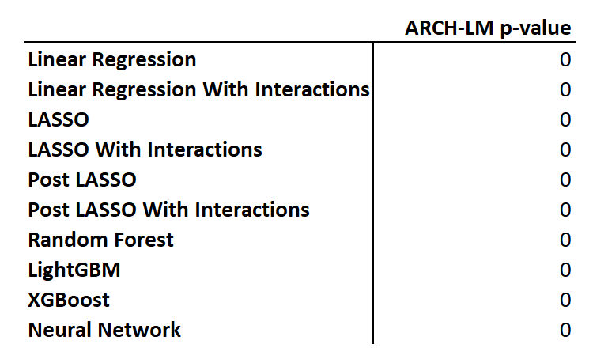
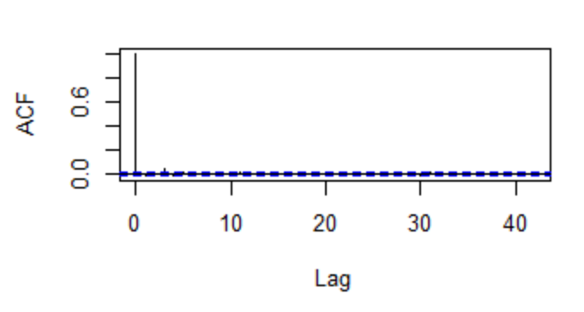
Appendix-Heteroscedasticity Test on Residuals
ARCH-LM Test Results
Autocorrelation
To check for heteroscedasticity, we performed the ARCH-LM test on the residuals of each model
The p-values of the ARCH-LM test suggest that our residuals are homoscedastic
The ACF graphs of each model are identical, which indicate that we have addressed the lag variables for our modelling

Slide 30
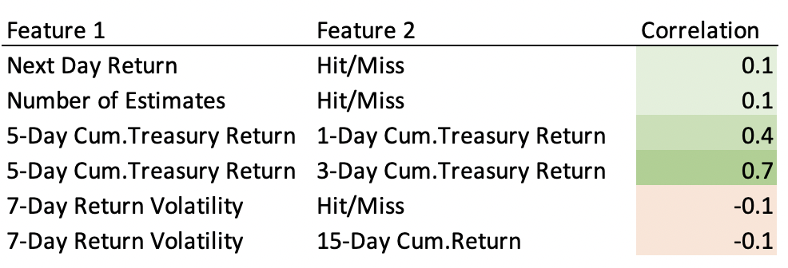
Exploratory Data Analysis - Correlation
Correlation: the Co-Movement of Features
A positive number implies the variables move in the same direction (i.e. if one increases, so does the other)
Magnitude of the number means strength of correlation (i.e. if Corr = 0.1, one feature moves 1 unit, the other feature moves 0.1 unit)
Selected Correlation Studies on Features
Weak feature correlation overall, unless features are calculated from the same base
Many believe that the next day return is correlated with the hit/miss earnings. Although we confirmed this, the strength of the correlation is really weak
Negative but weak correlation between the 7-Day return volatility and the Hit/Miss of EPS, as well as 15-Day cumulative return
Notes:
We conducted 2 types of correlational studies, one focusing mainly on the correlation of features within the feature group, the other one focusing mainly on the correlations of features outside its own group. The entire correlation study can be found in the Appendix slides. On this slide, we hand-picked a few interesting ones to discuss.
Many would think that the next-day return (our target variable) will be positively correlated to the Hit/Miss. We indeed found a positive correlation, but the strength of correlation is close to zero which means that the two features does not co-move strongly. Same result was found between the number of estimates and the Hit/Miss category.
The more interesting results comes from the Treasury and VIX return. We noticed that the 5-Day cumulative return for both Treasury and VIX Index are highly positively correlated to the 1- and 3-day return, showing a momentum effect in those two features.
The last thing noteworthy is the correlation between 7-day return volatility and Hit/Miss. We suspect a negative correlation but observe a negative correlation. The data tells us that if a company missed its earning, its 7-day return will become more volatile.

Slide 31
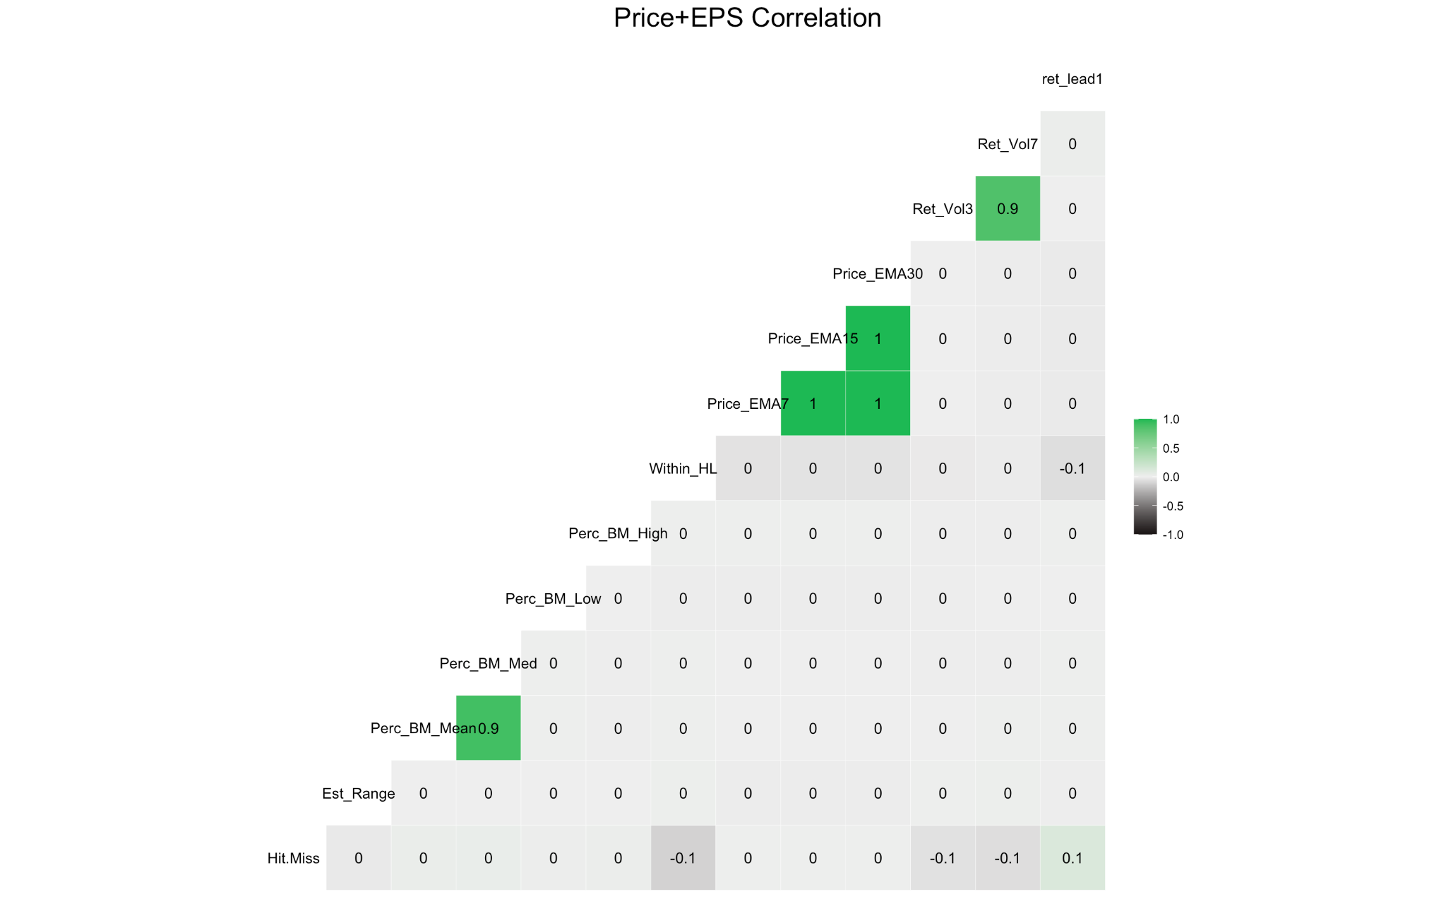
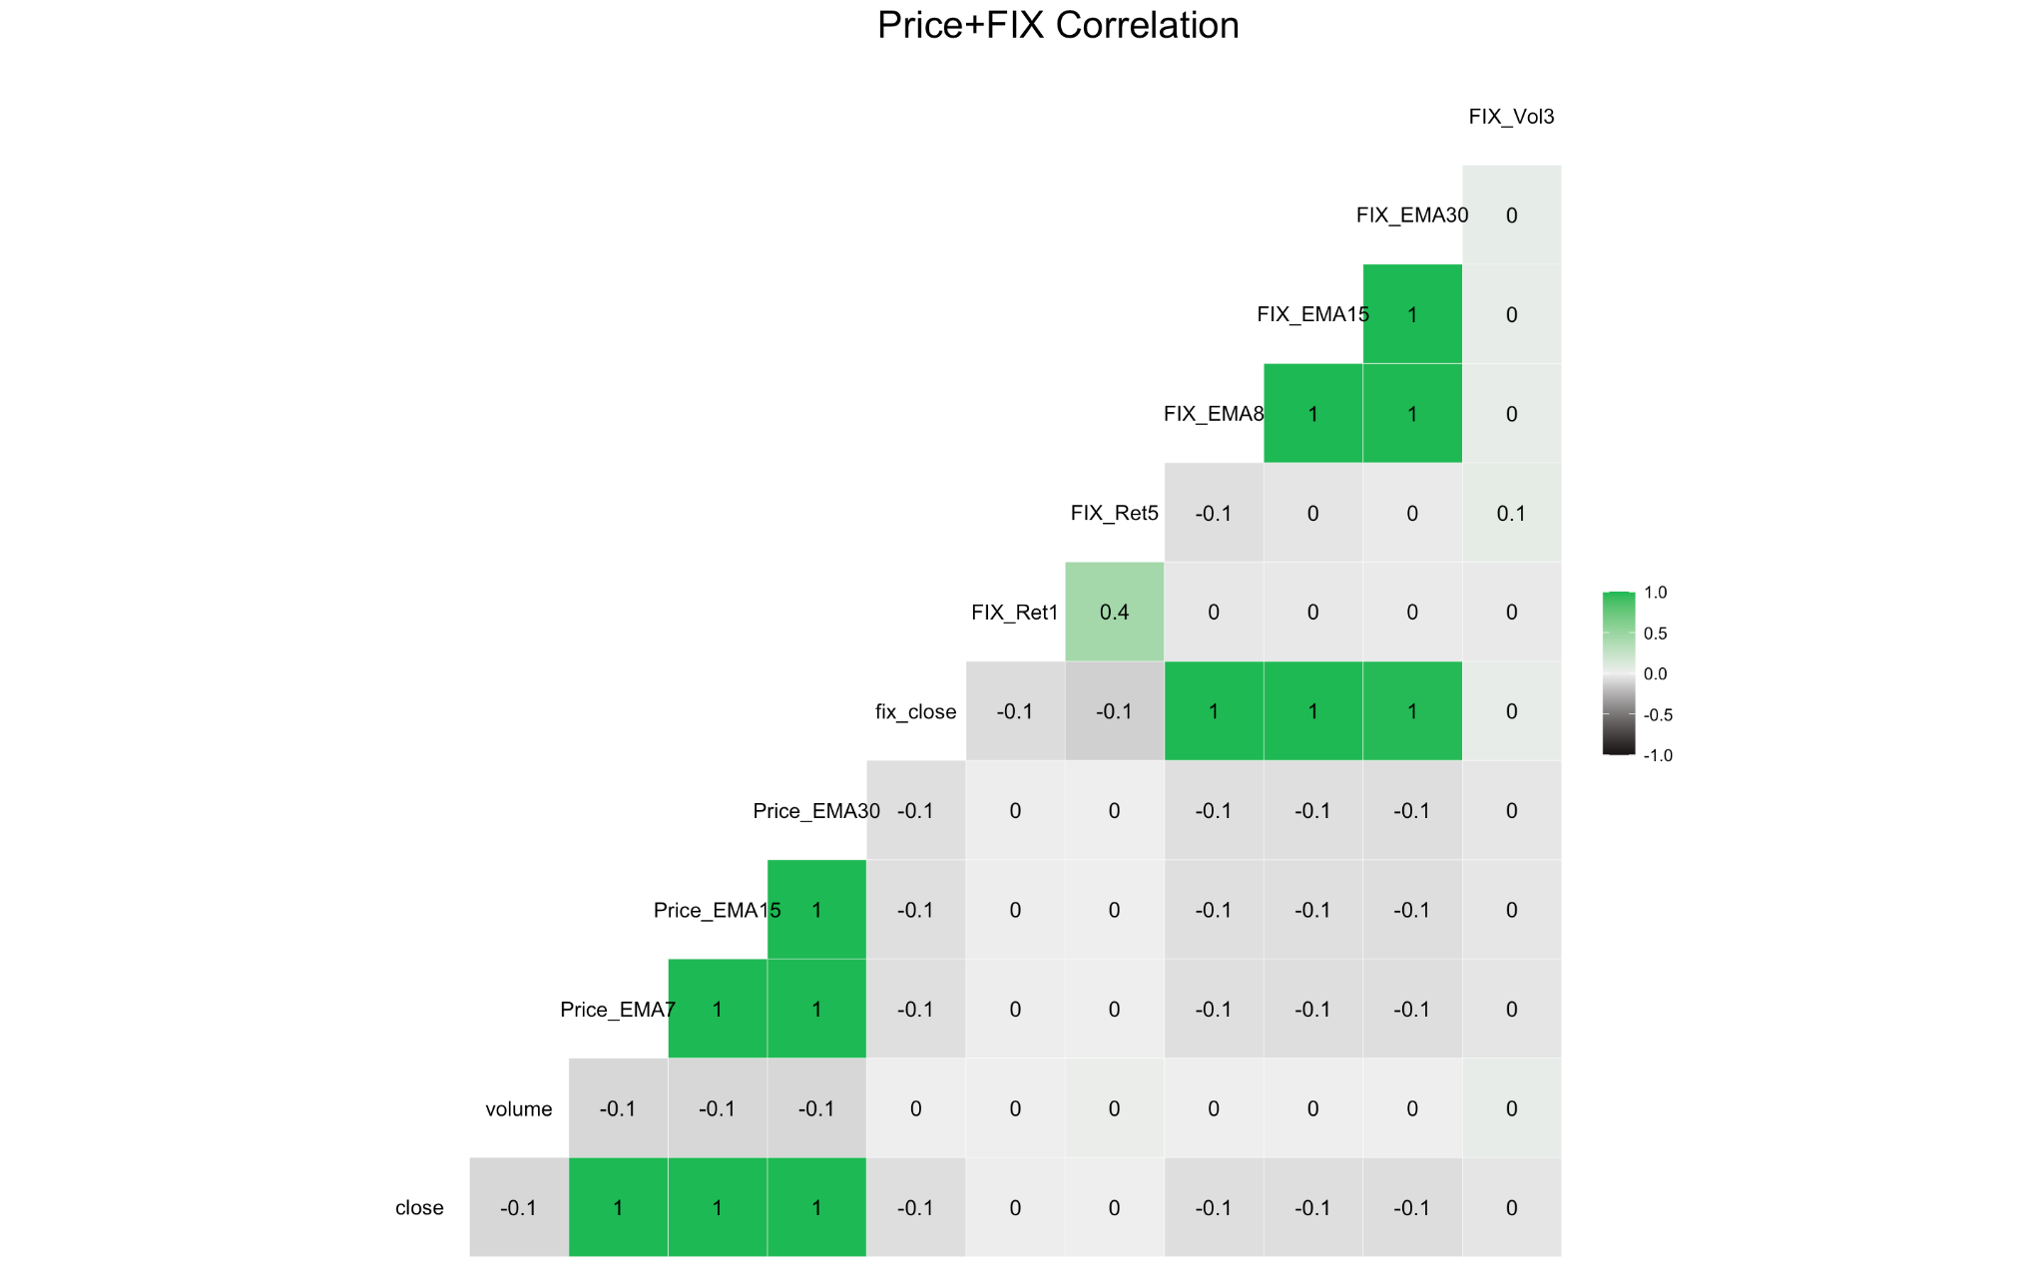
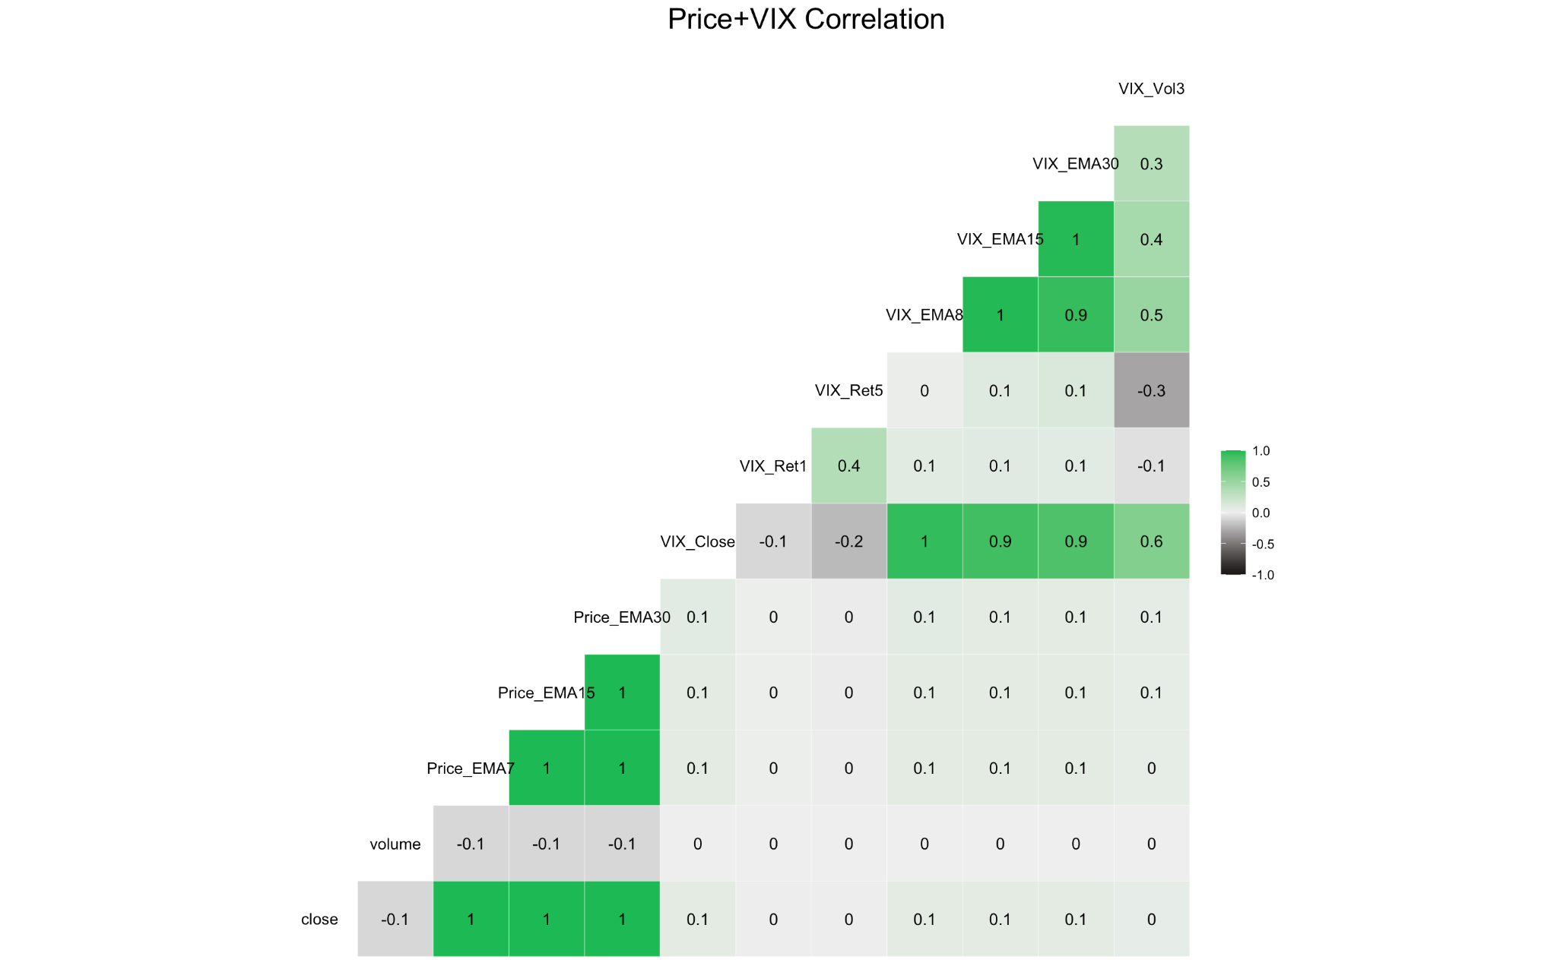
Appendix(EDA) -InterGroup Correlation
* Zoom in on any of the above graph to read more details. A highlight of significant correlations are provided in the formal slides.

Slide 32
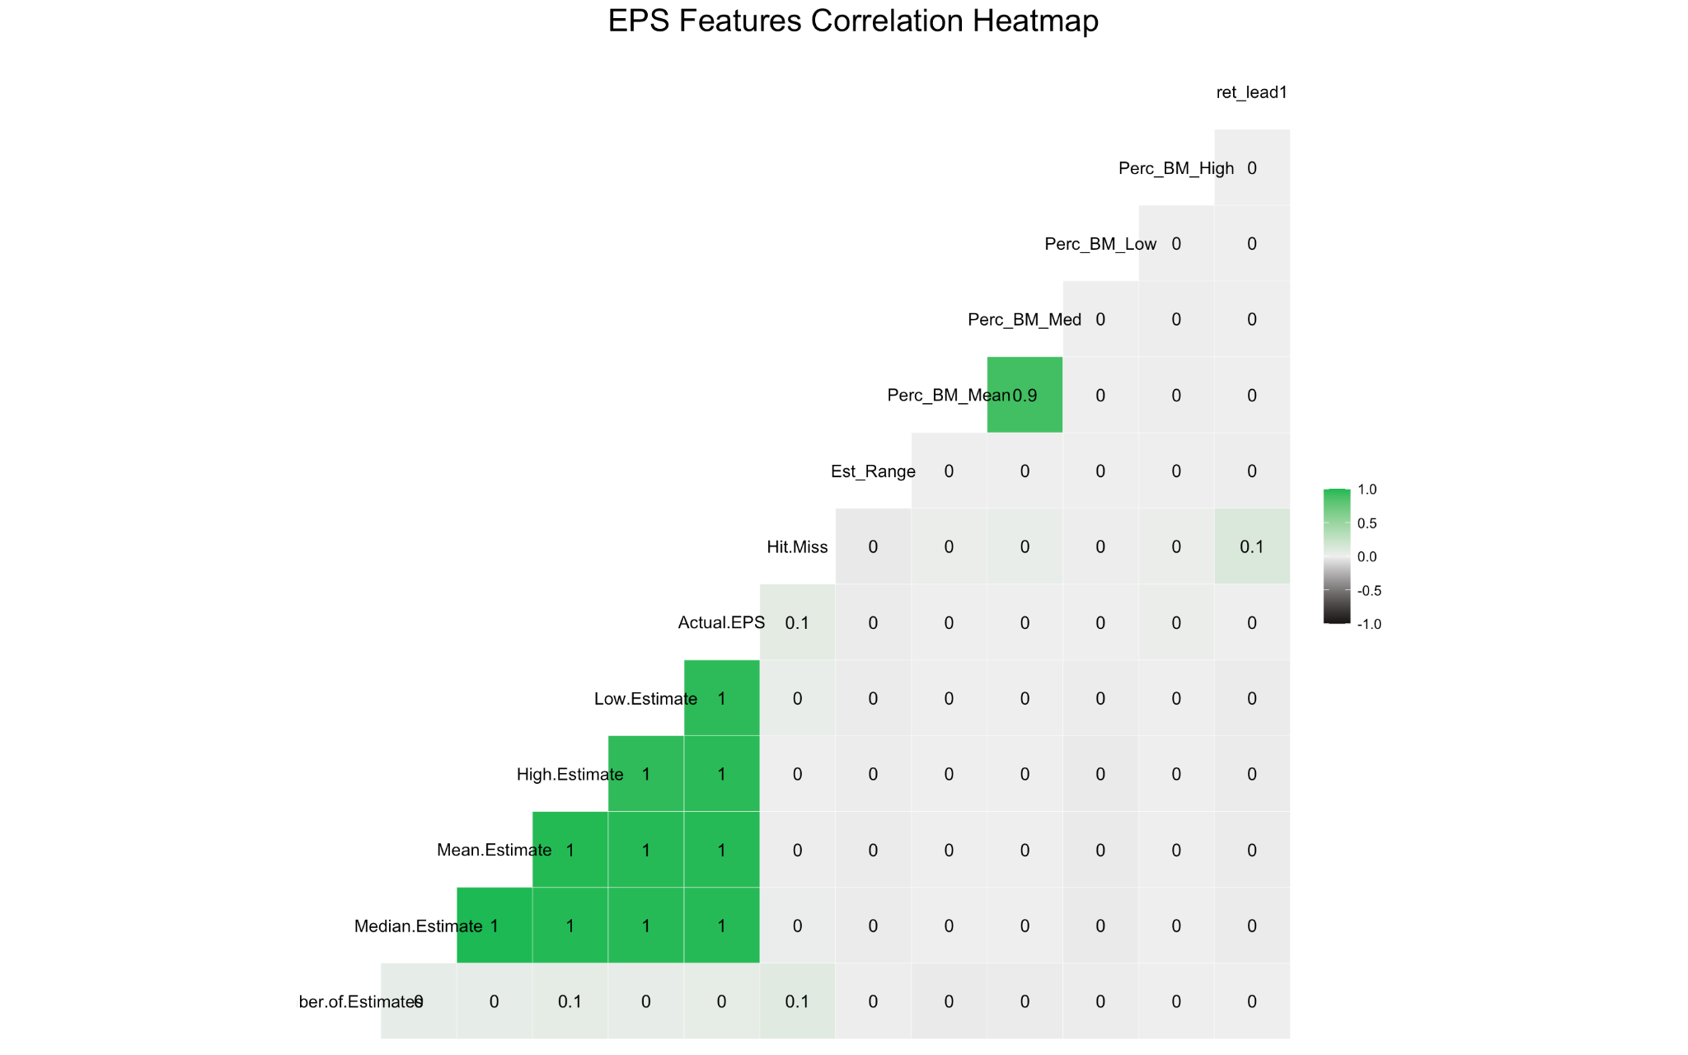
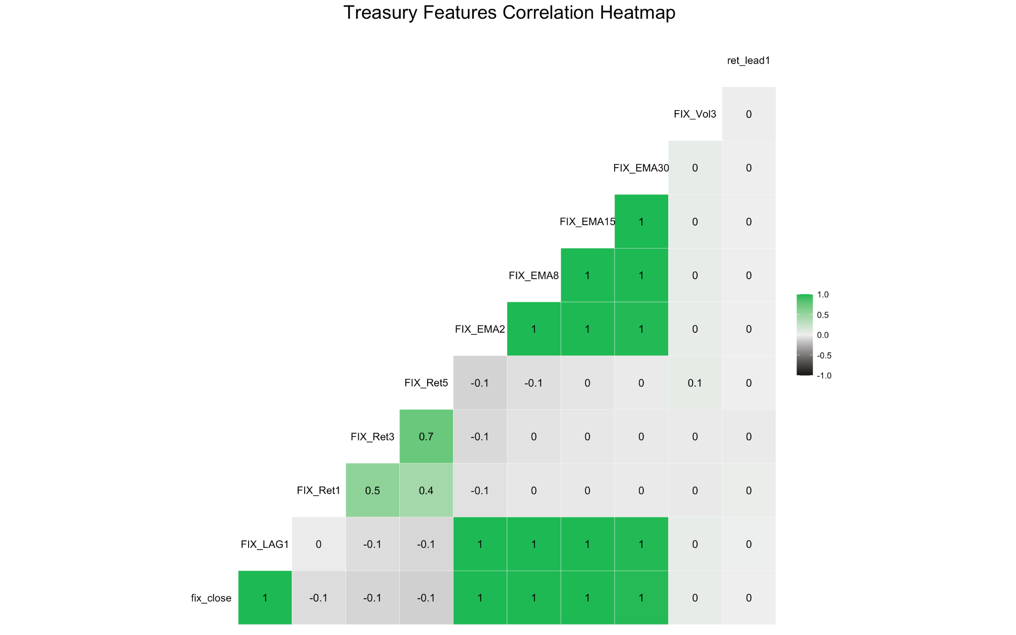
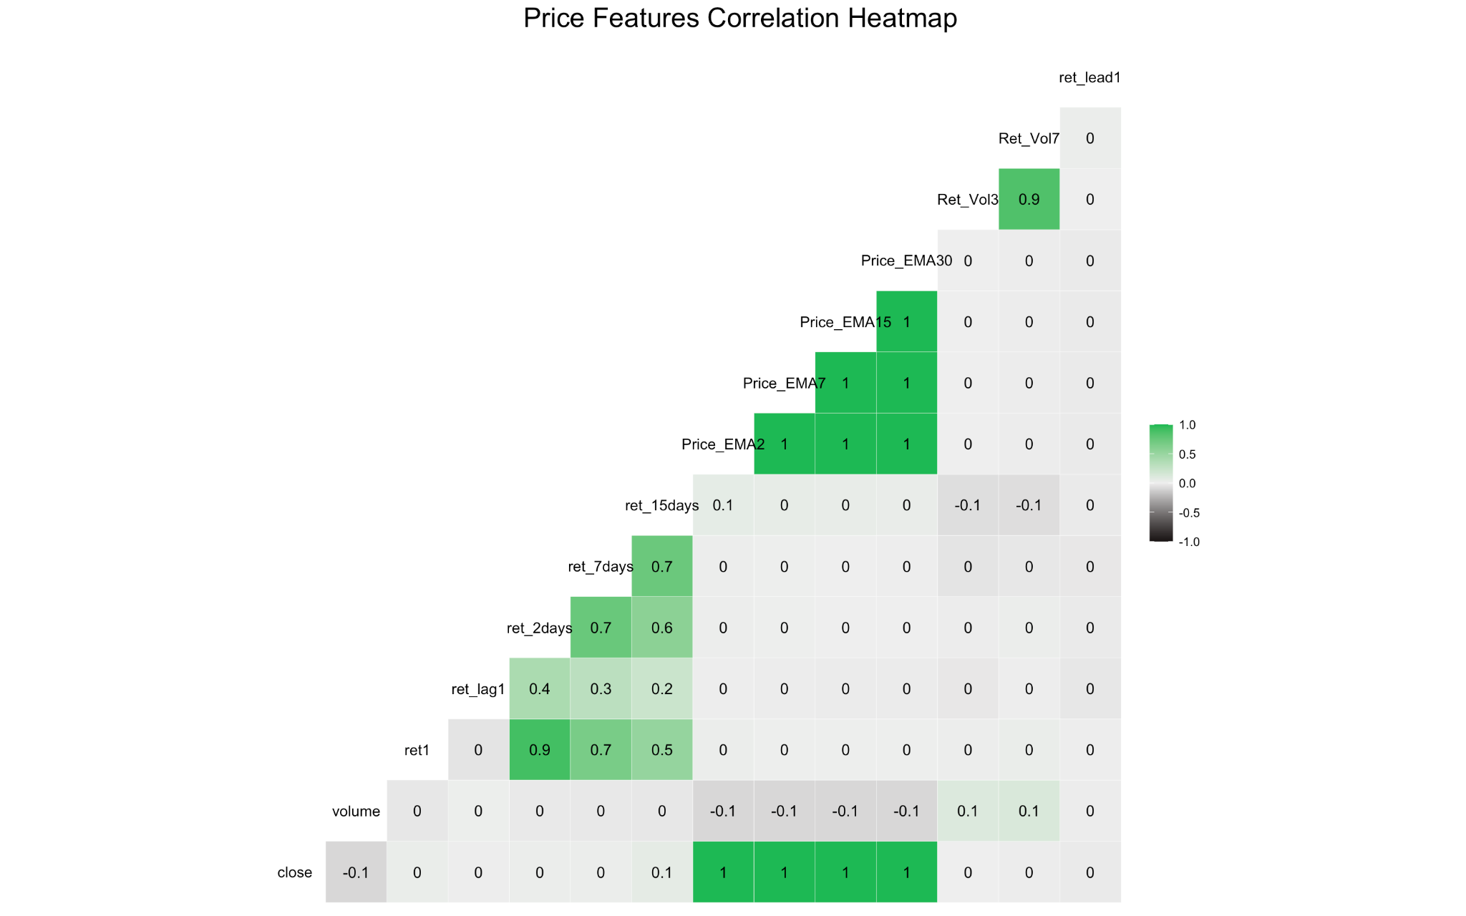
Appendix(EDA) -IntraGroup Correlation
* Zoom in on any of the above graph to read more details. A highlight of significant correlations are provided in the formal slides.

Slide 33
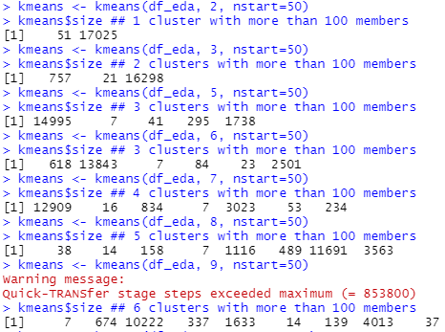
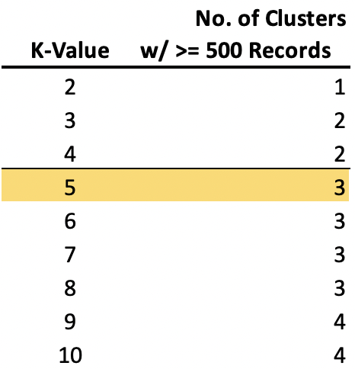
Appendix(EDA) -K-Means Clustering Part 1
Notes:
The purpose of conducting K-Means clustering is for us to explore the dataset and see if the data naturally forms any groups so that we can better conduct our analysis. Our hypothesis is that, with our current data set, the data can form clusters around industry, earning result, price movement etc. With more than 18,000 records and over 80 features, we started our K-means clustering process with 4 clusters and tried all the way to 10 clusters with 1 incremental. We found that no more than 6 clusters with >= 100 members can be formed no matter how we increase the K value. Due to the high number of dimensions, the clusters are hard to interpret. Therefore, we conducted further clustering by dividing the data into sub-categories, the results of which are shown in next few slides.

Slide 34
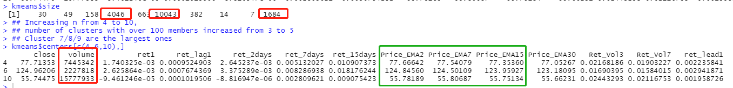
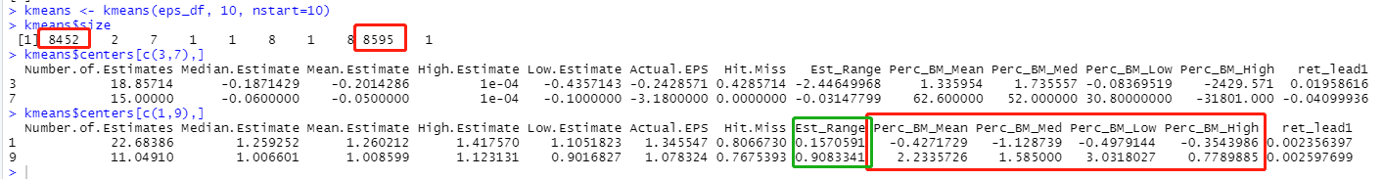
Appendix(EDA) -K-Means Clustering Part 2
Clustering on Price and Return Data
Hypothesized 3 clusters, observed 3 clusters
Cluster centers deviate the most on price exponential moving average and trading volume
Daily return all centered around 0
Clustering on Earnings and Estimates Data
Hypothesized 2 clusters, observed 2 clusters
Cluster centers deviate the most on Estimation Range and Percentage of Estimates Beat/Missed
One cluster is the records which beats expected earnings whereas the other cluster is the records which misses
Cluster centers, however, have similar post earning returns (cluster centers are at 0.0024 - 0.0026)
Notes:
We started with clustering Price and Return data. Our hypothesis is that three clusters will be formed within this group of data, which are the 1)high performing stocks with high return and price movement, 2)low performing stocks with large negative returns, and 3) value stocks whose return and pricement are relatively small. The clustering result showed indeed 3 largest clusters, each with more than 1000 records. However, when examining the clustering result, we found that the two of the largest three clusters are centered on positive returns. We suspect that this is due to a hidden sampling bias: most stocks beat their earning or lies within their earning estimates, and huge dive in stock prices post earnings are relatively uncommon.
We also conducted analysis on the Earnings data and found that the largest two clusters of earning data deviate the most on the range of analyst’s estimates. Because our Estimation Range is calculated as a % of actual EPS (i.e. a Esti.Range of 1 would mean that the range of estimates = the value of Actual EPS), the difference in the two cluster’s Est.Range is huge (0.91 vs 0.16). We found this consistent with our modeling result which suggests the range of analysts’ estimation explains a huge proportion of variances among data.

Slide 35
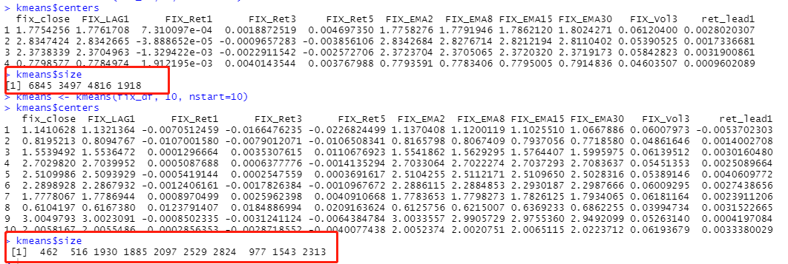
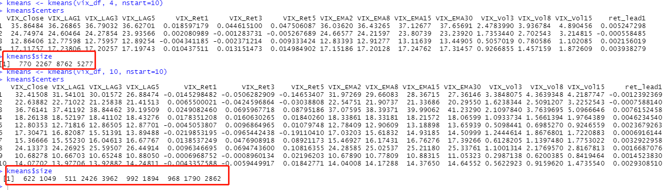
Appendix(EDA) -K-Means Clustering Part 3
Clustering on 10-Yr Treasury and VIX Index
Records are fairly evenly spread across the clusters
and no clusters are huge
Data variation among VIX and FIX data is huge due to market volatility and influences from external factors
As those two sets of data are not the primary target of investigation, we did not dive further in investigating why such clustering results appeared
However, one action step that we can take in the future is to use the cluster of both FIX and VIX as a feature, if the FIX and VIX clusters signals the market behavior
Notes:
We also conducted clustering analysis on the fixed income data and VIX Index data. We used an approach which was similar to the one we used in Part 1, starting with 4 clusters and moved all the way up to 10 clusters. Interestingly, we found that as we increase the number of clusters, the records become more spread across the clusters, with no clusters having less than 100 members and no clusters having more than ⅓ of the entire dataset. This shows that the data in the 10-Year Treasury and VIX Index are rather spread across. The hypothesis is that the FIX and VIX data behave in so many different ways as they are subject to huge external factor influences such as Macroeconomic factors and market participants actions. As the two set of data are not the main target of studying in this project, we did not investigate further on why this occurred.
However, one action step that we can take in the future is to use the cluster of both FIX and VIX as a feature, if the FIX and VIX clusters signals the market behavior.

Slide 36

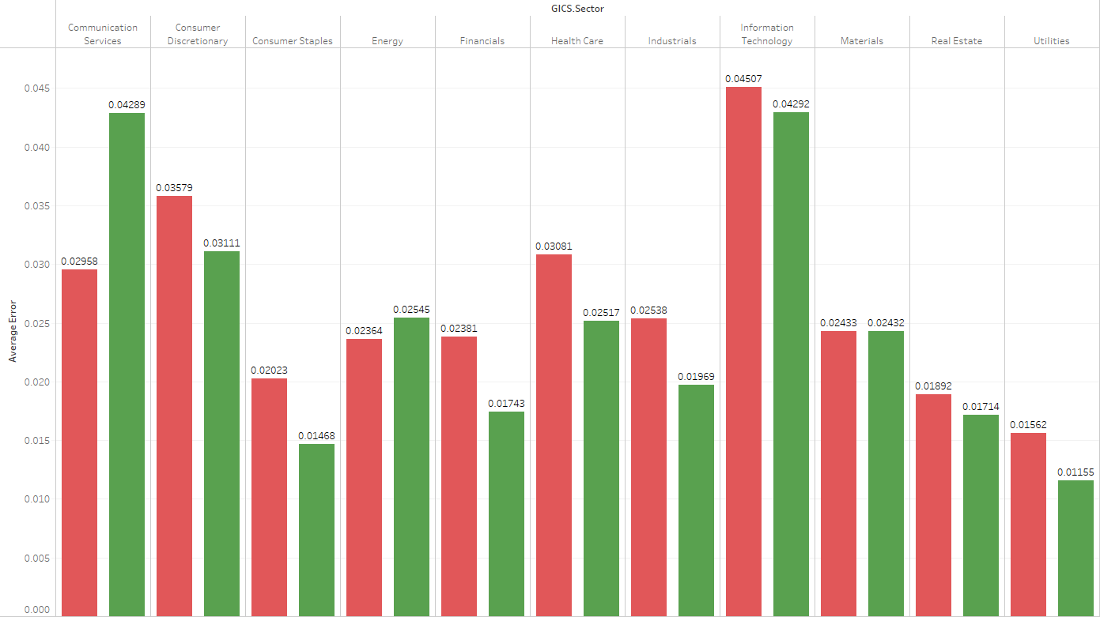
Notes:
Average model residue of different GICS

Slide 37
添加标题
点击此处添加文字内容
添加标题
点击此处添加文字内容
添加标题
点击此处添加文字内容
添加标题
添加标题
添加标题
点击此处添加文字说明内容，可以通过复制您的文本内容，在此文本框粘贴并选择只保留文字。
点击此处添加文字说明内容，可以通过复制您的文本内容，在此文本框粘贴并选择只保留文字。
点击此处添加文字说明内容，可以通过复制您的文本内容，在此文本框粘贴并选择只保留文字。
点击此处添加文字说明内容，可以通过复制您的文本内容，在此文本框粘贴并选择只保留文字。
点击此处添加文字说明内容，可以通过复制您的文本内容，在此文本框粘贴并选择只保留文字。
点击此处添加文字说明内容，可以通过复制您的文本内容，在此文本框粘贴并选择只保留文字。

Slide 38
1
年度工作概述
目录
CONTENTS
2
工作完成情况
3
成功项目展示
4
工作存在不足
5
明年工作计划

Slide 39
点击添加标题
点击添加标题
单击此处添加方法阐述，添加简短问题说明文字，方法与措施的具体说明文字添加此处。单击此处添加方法阐述，添加简短问题说明文字，方法与措施的具体说明文字添加此处。
单击此处添加方法阐述，添加简短问题说明文字，方法与措施的具体说明文字添加此处。单击此处添加方法阐述，添加简短问题说明文字，方法与措施的具体说明文字添加此处。
方法二
方法一
方法三
点击添加标题
方法四
单击此处添加方法阐述，添加简短问题说明文字，方法与措施的具体说明文字添加此处。单击此处添加方法阐述，添加简短问题说明文字，方法与措施的具体说明文字添加此处。
点击添加标题
单击此处添加方法阐述，添加简短问题说明文字，方法与措施的具体说明文字添加此处。单击此处添加方法阐述，添加简短问题说明文字，方法与措施的具体说明文字添加此处。

Slide 40
添加标题
点击此处添加文字内容
添加标题
点击此处添加文字内容
添加标题
点击此处添加文字内容
添加标题
添加标题
添加标题
点击此处添加文字说明内容，可以通过复制您的文本内容，在此文本框粘贴并选择只保留文字。
点击此处添加文字说明内容，可以通过复制您的文本内容，在此文本框粘贴并选择只保留文字。
点击此处添加文字说明内容，可以通过复制您的文本内容，在此文本框粘贴并选择只保留文字。
点击此处添加文字说明内容，可以通过复制您的文本内容，在此文本框粘贴并选择只保留文字。
点击此处添加文字说明内容，可以通过复制您的文本内容，在此文本框粘贴并选择只保留文字。
点击此处添加文字说明内容，可以通过复制您的文本内容，在此文本框粘贴并选择只保留文字。

Slide 41
您的内容打在这里，或者通过复制您的文本后，在此框中选择粘贴，并选择只保留文字。您的内容打在这里，或者通过复制您的文本后，在此框中选择粘贴，并选择只保留文字。
您的内容打在这里，或者通过复制您的文本后，在此框中选择粘贴，并选择只保留文字。
点击添加文本
点击添加文本
点击添加文本
点击添加文本

Slide 42
输入你的标题
输入你的标题
点击输入简要文字内容，文字内容需概括精炼，不用多余的文字修饰，言简意赅的说明分项内容。
点击输入简要文字内容，文字内容需概括精炼，不用多余的文字修饰，言简意赅的说明分项内容。
输入
标题
输入你的标题
输入你的标题
点击输入简要文字内容，文字内容需概括精炼，不用多余的文字修饰，言简意赅的说明分项内容。
点击输入简要文字内容，文字内容需概括精炼，不用多余的文字修饰，言简意赅的说明分项内容。
输入你的标题
输入你的标题
点击输入简要文字内容，文字内容需概括精炼，不用多余的文字修饰，言简意赅的说明分项内容。
点击输入简要文字内容，文字内容需概括精炼，不用多余的文字修饰，言简意赅的说明分项内容。

Slide 43

单击此处添加标题
点击输入简要文字内容，文字内容需概括精炼，不用多余的文字修饰，言简意赅的说明分项内容。点击输入简要文字内容，文字内容需概括精炼，不用多余的文字修饰，言简意赅的说明分项内容。
添加标题
添加标题
添加标题
单击此处添加标题
添加标题
点击输入简要文字内容，文字内容需概括精炼，不用多余的文字修饰，言简意赅的说明分项内容。点击输入简要文字内容，文字内容需概括精炼，不用多余的文字修饰，言简意赅的说明分项内容。
添加标题

Slide 44
1
年度工作概述
目录
CONTENTS
2
工作完成情况
3
成功项目展示
4
工作存在不足
5
明年工作计划

Slide 45
1
点击添加标题内容（权重50%）
是体现公司价值创造成果的最直接的效益指标。如投资资本回报率、息税前利润等。
2
[ 标题内容 ]
点击添加标题内容（权重30%）
为实现公司价值增长的重要营运操作控制活动的效果。如行政管理费用、大客户投诉次数等。
3
点击添加标题内容（权重20%）
用来评估员工管理、激励与职业发展等保持公司长期稳定发展的能力。如员工人数控制、员工满意度等。

Slide 46
点击输入简要文字解说，解说文字尽量概括精炼，不用多余的文字修饰，简洁精准的 解说所提炼的核心概念。
点击输入简要文字解说，解说文字尽量概括精炼，不用多余的文字修饰，简洁精准的 解说所提炼的核心概念。
点击输入简要文字解说，解说文字尽量概括精炼，不用多余的文字修饰，简洁精准的 解说所提炼的核心概念。
1、2月份
3、4月份
5、6月份
7、8月份
9、10月份
11、12月份
点击输入简要文字解说，解说文字尽量概括精炼，不用多余的文字修饰，简洁精准的 解说所提炼的核心概念。
点击输入简要文字解说，解说文字尽量概括精炼，不用多余的文字修饰，简洁精准的 解说所提炼的核心概念。
点击输入简要文字解说，解说文字尽量概括精炼，不用多余的文字修饰，简洁精准的 解说所提炼的核心概念。

Slide 47
100
90
80
70
60
50
40
30
20
10
10
20
30
40
50
60
70
80
90
100
输入文字
A
输入文字
输入文字
B
输入文字
输入文字
C
输入文字
输入文字
D
输入文字
输入文字
E
输入文字
输入文字
F
输入文字
输入文字
G
输入文字
在此录入图表的综合描述说明。在此录入上述图表的综合描述说明，在此录入上述图表的综合描述说明，在此录入上述图表的综合描述说明，在此录入上述图表的综合描述说明，在此录入上述图表的综合描述说明。

Slide 48
添加标题
添加标题
在此录入上述图表的描述说明
在此录入上述图表的描述说明
在此录入上述图表的描述说明在此录入上述图表的描述说明
添加标题
在此录入上述图表的描述说明在此录入上述图表的描述说明
添加标题
在此录入上述图表的描述说明在此录入上述图表的描述说明
添加标题
添加标题
在此录入上述图表的描述说明在此录入上述图表的描述说明
在此录入上述图表的描述说明
在此录入上述图表的描述说明

Slide 49
1
年度工作概述
目录
CONTENTS
2
工作完成情况
3
成功项目展示
4
工作存在不足
5
明年工作计划

Slide 50
添加标题内容
添加文字描述
领导力是一种影响力，领导即是一种影响过程，是影响人们心甘情愿和满怀热情为实现组织目标而努力的艺术或过程。
添加内容
添加标题内容
添加文字描述
现代领导者的才能就是其影响力，真正的领导者是能够影响别人，使别人追随自己的人物。
添加标题内容
添加文字描述
结合前面领导力的定义，我们发现，领导力实质就是领导者的影响力，即领导者拥有影响被领导者的能力或力量。

Slide 51
单击添加标题文本
单击添加标题文本
点击输入简要文字内容，文字内容需概括精炼，不用多余的文字修饰。
点击输入简要文字内容，文字内容需概括精炼，不用多余的文字修饰。
01
04
工作不足
单击添加标题文本
单击添加标题文本
点击输入简要文字内容，文字内容需概括精炼，不用多余的文字修饰。
02
05
点击输入简要文字内容，文字内容需概括精炼，不用多余的文字修饰。
03
06
单击添加标题文本
单击添加标题文本
点击输入简要文字内容，文字内容需概括精炼，不用多余的文字修饰。
点击输入简要文字内容，文字内容需概括精炼，不用多余的文字修饰。

Slide 52
在此录入上述图表的综合描述说明，在此录入上述图表的综合描述说明。在此录入上述图表的描述说明，在此录入上述图表的描述说明，在此录入上述图表的综合描述说明，在此录入上述图表的综合描述说明。
标题内容
标题内容
标题内容
标题内容
输入小标题内容
输入小标题内容
输入小标题内容
输入小标题内容
在此录入上述图表的描述说明，在此录入上述图表的描述说明，在此录入上述图表的描述说明。
在此录入上述图表的描述说明，在此录入上述图表的描述说明，在此录入上述图表的描述说明。
在此录入上述图表的描述说明，在此录入上述图表的描述说明，在此录入上述图表的描述说明。
在此录入上述图表的描述说明，在此录入上述图表的描述说明，在此录入上述图表的描述说明。

Slide 53



单击此处添加标题
—
点击此处添加文字说明内容，可以通过复制您的文本内容，在此文本框粘贴并选择只保留文字内容。
单击此处添加标题
—
点击此处添加文字说明内容，可以通过复制您的文本内容，在此文本框粘贴并选择只保留文字内容。

Slide 54
此处添加标题内容
此处添加标题内容
点击输入简要文字内容，文字内容需概括精炼，不用多余的文字修饰，言简意赅的说明分项内容。
点击输入简要文字内容，文字内容需概括精炼，不用多余的文字修饰，言简意赅的说明分项内容。
此处添加标题内容
此处添加标题内容
点击输入简要文字内容，文字内容需概括精炼，不用多余的文字修饰，言简意赅的说明分项内容。
点击输入简要文字内容，文字内容需概括精炼，不用多余的文字修饰，言简意赅的说明分项内容。

Slide 55
1
年度工作概述
目录
CONTENTS
2
工作完成情况
3
成功项目展示
4
工作存在不足
5
明年工作计划

Slide 56
点击输入标题文本
点击输入简要文字内容，文字内容需概括精炼，不用多余的文字修饰，言简意赅的说明分项内容。点击输入简要文字内容，文字内容需概括精炼，不用多余的文字修饰，言简意赅的说明分项内容。
点击输入标题文本
点击输入简要文字内容，文字内容需概括精炼，不用多余的文字修饰，言简意赅的说明分项内容。点击输入简要文字内容，文字内容需概括精炼，不用多余的文字修饰，言简意赅的说明分项内容。
工作总结
点击输入标题文本
点击输入简要文字内容，文字内容需概括精炼，不用多余的文字修饰，言简意赅的说明分项内容。点击输入简要文字内容，文字内容需概括精炼，不用多余的文字修饰，言简意赅的说明分项内容。
点击输入标题文本
点击输入简要文字内容，文字内容需概括精炼，不用多余的文字修饰，言简意赅的说明分项内容。点击输入简要文字内容，文字内容需概括精炼，不用多余的文字修饰，言简意赅的说明分项内容。

Slide 57
与上一年的比较
2016年基本情况
2017年基本情况
简单的介绍本年的工作基本情况，表明几个比较的基本方面，结合下面的图形做出直观的对比。简单的介绍本年的工作基本情况，表明几个比较的基本方面。
简单的介绍本年的工作基本情况，表明几个比较的基本方面，结合下面的图形做出直观的对比。简单的介绍本年的工作基本情况，表明几个比较的基本方面。
计划完成：三千万元
VS
计划完成：四千万元
实际完成数：28，019，800
实际完成数：42，810，800
完成：93.33%
完成：107%
回款数：20，745，100
回款数：39，865，800
其他数据
其他数据
其他数据
其他数据

Slide 58
_{添加标题}
您的内容打在这里，或者通过复制您的文本后。您的内容打在这里，或者通过复制您的文
_{添加标题}
您的内容打在这里，或者通过复制您的文本后。您的内容打在这里，或者通过复制您的文
_{添加标题}
添加标题
添加标题
_{添加标题}
_{添加标题}
_{添加标题}
_{添加标题}
_{添加标题}
_{添加标题}
_{添加标题}
您的内容打在这里，或者通过复制您的文本后。您的内容打在这里，或者通过复制您的文
_{添加标题}
_{添加标题}
_{添加标题}

Slide 59
这里添加你
的标题内容
这里添加你
的标题内容
这里添加你
的标题内容
这里添加你
的标题内容
2013
2014
2016
2017
点击添加内容
点击添加内容
点击添加内容
点击添加内容
在这里添加你需要的文字内容，请根据自己要求更改。在这里添加你需要的文字内容，请根据自己要求更改。
在这里添加你需要的文字内容，请根据自己要求更改。在这里添加你需要的文字内容，请根据自己要求更改。
在这里添加你需要的文字内容，请根据自己要求更改。在这里添加你需要的文字内容，请根据自己要求更改。
在这里添加你需要的文字内容，请根据自己要求更改。在这里添加你需要的文字内容，请根据自己要求更改。

Slide 60
01
添加标题内容
点击输入简要文字内容，文字内容需概括精炼，不用多余的文字修饰，言简意赅的说明分项内容。点击输入简要文字内容，文字内容需概括精炼，不用多余的文字修饰……
添加标题内容
点击输入简要文字内容，文字内容需概括精炼，不用多余的文字修饰，言简意赅的说明分项内容。点击输入简要文字内容，文字内容需概括精炼，不用多余的文字修饰……
总体目标
添加标题内容
04
02
点击输入简要文字内容，文字内容需概括精炼，不用多余的文字修饰，言简意赅的说明分项内容。点击输入简要文字内容，文字内容需概括精炼，不用多余的文字修饰……
添加标题内容
点击输入简要文字内容，文字内容需概括精炼，不用多余的文字修饰，言简意赅的说明分项内容。点击输入简要文字内容，文字内容需概括精炼，不用多余的文字修饰……
03

